Slide 1
Evaluating the Impact of Interconnections in Quantum-dot Cellular Automata (QCA)
Frank Sill Torres^{1,2}, Robert Wille^{1,3}, Marcel Walter²,
Philipp Niemann^{1,2}, Daniel Große^{1,2}, Rolf Drechsler^{1,2}
¹DFKI GmbH (Germany), ²University of Bremen (Germany)
³JKU Linz (Austria)

Slide 2

Outline
Motivation
Design Automation
Analysis Environment
Results
Conclusions

Slide 3
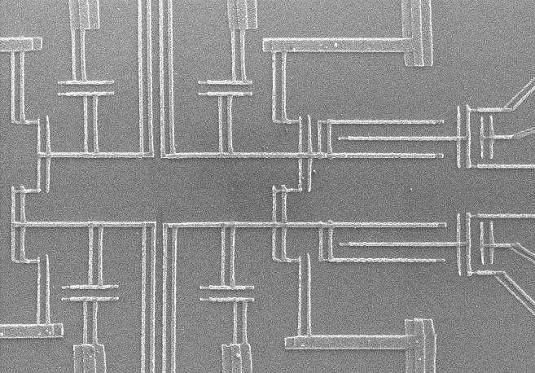
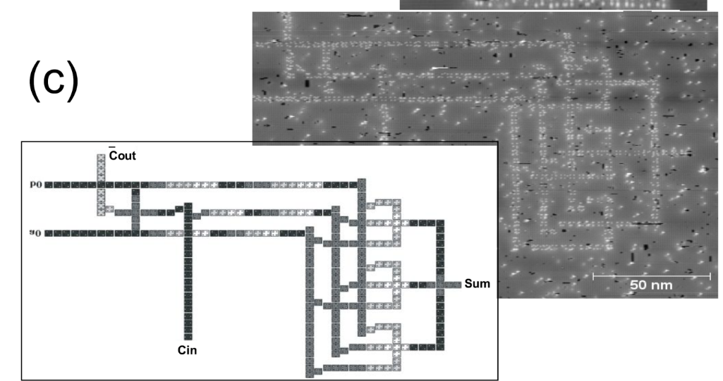
Motivation
Quantum-dot Cellular Automata (QCA)
Promising nanotechnology based on quantum dots
Remarkable low energy dissipation
Several (experimental) physical realizations based on different concepts (Metal islands, nanomagnets, dangling bonds, …)
Nanomagnets
Metal islands
Dangling bonds

Slide 4
Motivation
Interconnections
Challenging routing in QCA
  QCA is (nearly) planar technology
    Current state: 1 layer for logic & routing, 1 layer for crossings
    Outlook: low amount of layers
  Data flow must follow clocking constraint (clock 1 → clock 2 → clock 3 → … )
  Only orthogonal routing
Simple example:
Routing overhead

Slide 5
Motivation
Interconnections cont’d
More complex design
Interconnections with notable impact on Area, Delay, Energy increase
Question: What is the actual impact?

Slide 6
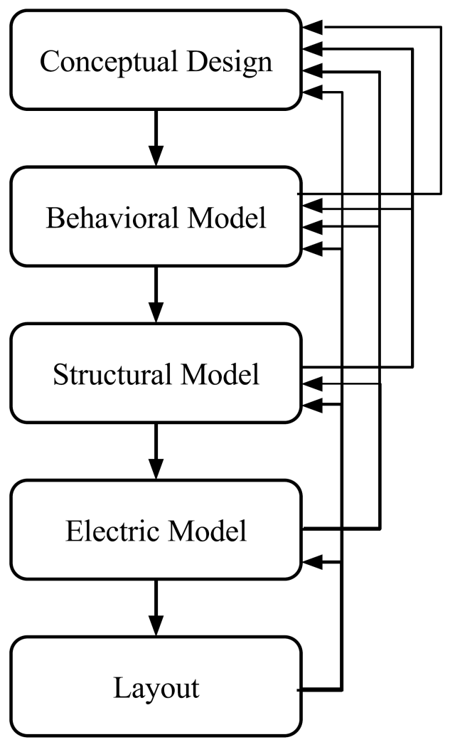
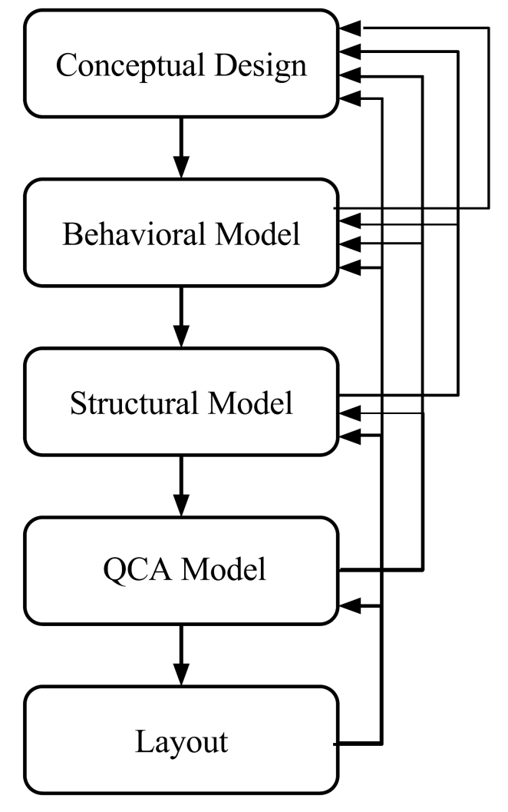
Design Automation
Comparison
CMOS Process
QCA Process
No Differences
Some Differences
Transistors and
connections
QCA cells and
its positions
Layers of specific material
MOS layers

Slide 7
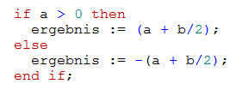
Design Automation
Principal Flow
HDL Description
Tile (clock zone) grid
Netlist
Layout

Slide 8
Design Automation
Gate Library
Routing Elements
Simple Gates
Complex Gates
Wire
Inverter
NOR
Bent wire
Majority
Fanout
OR
XOR

Slide 9
Design Automation
Energy Model
Components of energy dissipation of QCA:
Dissipated energy: E_{env} = E_{clk} + E_{in} – E_{out}
QCADesigner-E - Physics simulator including determination of energy dissipation of QCA (https://github.com/FSillT/QCADesigner-E)
E_{clk} - Energy from clock
E_{in} - Energy from
neighboring cell(s)
-
E_{out} - Energy to
neighboring cell(s)
-
E_{env} - Energy to environment

Slide 10
Design Automation
Characterized Gate library
 |  | Area [µm²] | Delay [tiles] | Energy Disspation [meV]
 |  |  |  | Regl. Mode (25 GHz) |  |  | Fast mode (100 GHz)
 |  |  |  | 000 | ... | 111 | 000 | ... | 111
Routing Elements | Wire | 0.01 | 1 | 0.09 | ... | - | 0.82 | ... | -
 | Bent-wire | 0.01 | 1 | 0.10 | ... | - | 0.84 | ... | -
 | Fanout | 0.01 | 1 | 0.12 | ... | - | 1.15 | ... | -
Logic Gates | Inverter | 0.01 | 1 | 0.13 | ... | - | 1.19 | ... | -
 | Majority | 0.01 | 1 | 0.15 | ... | 0.15 | 1.41 | ... | 1.41
 | OR | 0.01 | 1 | 0.18 | ... | - | 1.30 | ... | -
 | NOR | 0.02 | 2 | 0.31 | ... | - | 2.49 | ... | -
 | ... | ... | ... | ... | ... | ... | ... | ... | ...

Slide 11
Analysis Environment
P&R Algorithm
Diagonal arrangement of clocking
Levelizing of netlist graph
Diagonal placement of each level
Routing

Slide 12
Analysis Environment
Flow
Synthesis:
  Synthesis library (*.lib) for QCA gate library
  Synopsys Design Compiler
  ABC (AIG, BDD)
EFPL Benchmarks
Benchmark name | Inputs | Outputs | AND nodes
Adder (adder) | 256 | 129 | 1020
Barrel shifter (barrel) | 135 | 128 | 3336
Max (max) | 512 | 130 | 2865
Sine (sin) | 24 | 25 | 5416
... | … | … | …

Slide 13
Results
Area

Slide 14
Results
Delay

Slide 15
Results
Energy Dissipation

Slide 16
Conclusions
QCA is a promising nanotechnology for low energy applications
Specific characteristics of QCA design require notable amount of interconnections
Here: Evaluation of this impact
Results indicate high impact of Interconnections with consequences on area, delay, energy
Requirements for future research:
  Comprehensive synthesis cost model for interconnections
  New synthesis strategies with emphasis on reduction of interconnections
  Exploration of new concepts (systolic arrays, logic duplication, …)

Slide 17
Thank you!
frasillt@uni-bremen.de

Slide 18
Evaluating the Impact of Interconnections in Quantum-dot Cellular Automata (QCA)
Frank Sill Torres^{1,2}, Robert Wille^{1,3}, Marcel Walter², Philipp Niemann^{1,2}, Daniel Große^{1,2}, Rolf Drechsler^{1,2}
¹DFKI GmbH (Germany), ²University of Bremen (Germany)
³JKU Linz (Austria)

