Slide 1

Exploration of Technology Parameter Values of Integrated Circuits
Rodrigo Fonseca Rocha Soares – UFMG
Frank Sill Torres – DELT/UFMG
Dirk Timmermann – University of Rostock

Slide 2
Focus / Principal idea:
Technology Parameter Exploration of Integrated Circuits
Standard-Cell Characterization Flow for Novel Technologies

Slide 3

Outline
Motivation
Methodology
Results
Conclusion

Slide 4
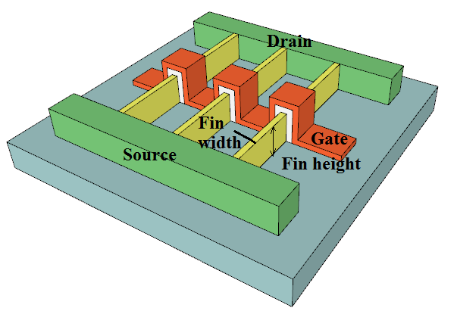
Motivation
Technology Parameters
Integrated circuit technologies offer two kind of parameters:
  Design parameters (e.g. transistor width, transistor length)
  Technology parameters (e.g. doping, oxide thickness)
Design parameters
  Constrained
  Modifiable by circuit designers
Technology parameters:
  Constrained
  Not accessible by circuit designers
  Can be oriented to consumer applications profiles
  (e.g. High performance / Low-power)

Slide 5
Motivation
Technology Parameter Values
Question: How to chose values for technology parameters?
Several constraints: I_{on} vs. I_{off} currents, area, gain, …
Interesting for:
  Technology engineers
  Researchers for novel technologies (CNTFET, SET, …)
Common approach:
  Analysis using selected cells
  (FO4 configuration)
  Sweep of input parameters
  (e.g. slope, input value, …)

Slide 6
Motivation
Novel Approach
Problem: Common solution not accurate enough
Example: Average CMOS PTM22 gains in relation to CMOS PTM32
Proposal:
  Analysis of technology parameter based on actual designs
53%
8%
16%

Slide 7
Methodology
Presentation
Principal ideas:
  Analysis of technology parameters impact using characterized standard cell library and test designs
  Interactive parametric exploration
Application of comercial tool(s) for standard cell library characterization
Technology can be given on Spice, Circuit, or Verilog-A level
Test designs oriented in future application of selected technology

Slide 8
Methodology
Two step flow:
  Pre-Setup
  Technology Parameter Exploration
Pre-Setup
  Environment Setup
  Standard-cell representation
Technology parameter Exploration
  Standard-cell characterization
  Benchmark and analysis

Slide 9
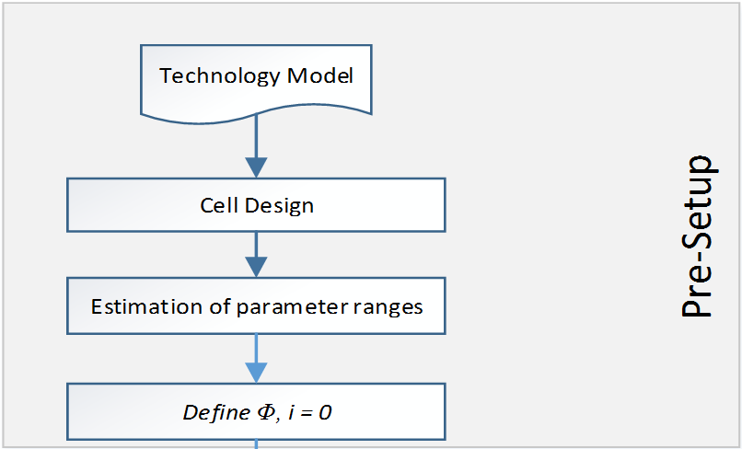
Methodology
Pre-Setup Stage:
Design of standard cell library with default parameter values
Extraction of parameters for look-up tables in characterization flow
Selection of most important technology parameters and its ranges for exploration

Slide 10
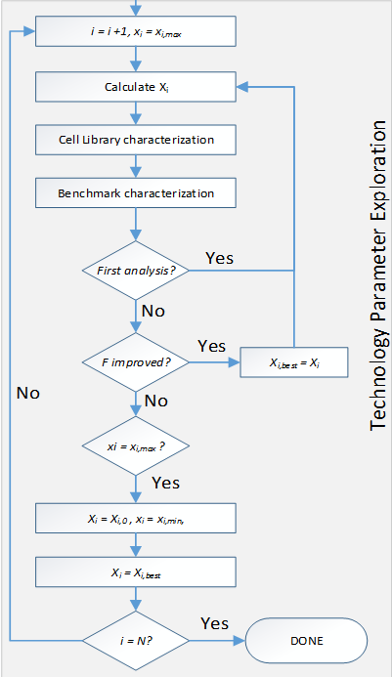
Methodology
Technology Parameter Exploration
Start parameters with default values
Perform characterization and benchmark with actual designs
Figure of Merit evaluation and analysis
Iterate

Slide 11
Results
Environment
Analyzed Technologies:
  PTM22 and PTM32 (based on Predictive Technology Model - PTM)
  FINFET10-HP FINFET10LL (based on PTM)
  CNTFET32 and CNTFET22 (based in Stanford CNFET Model)
Basic standard cell library (10 cells, different sizes, FlipFlop)
Test Designs:
  ISCAS suite: c1908, c2670, c3540, c5315, c7552
  ITC99 suite: b01, b05
Tools:
  Cell library characterization: SiliconSmart (Synopsys)
  Simulation: Virtuoso Analog Design Environment (Cadence)

Slide 12
Results
Technology Comparison – Delay (t_{delay})
Versus results for PTM32

Slide 13
Results
Technology Comparison - Power Delay Product (PDP)
Versus results for PTM32

Slide 14
Results
Technology Comparison – Leakage (P_{leak})
Versus results for PTM32

Slide 15
Results
Technology Comparison
Comparison of relation to PTM32 of FO4 analysis and proposed flow

Slide 16
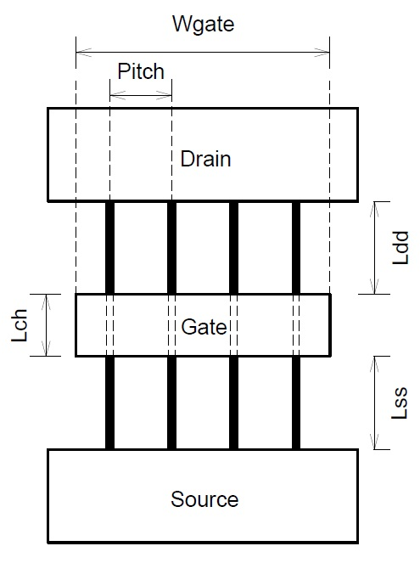
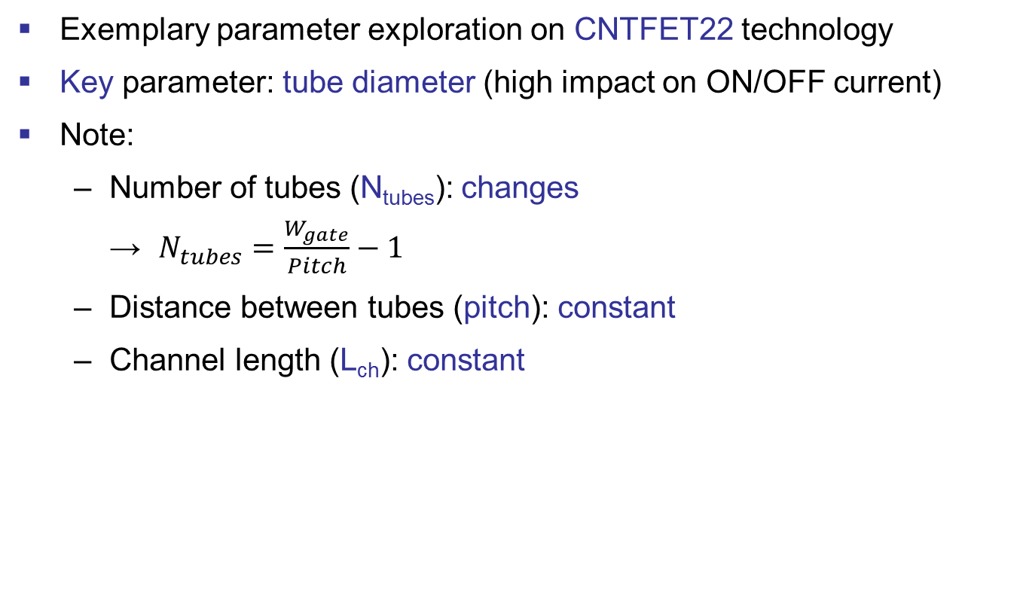
Results
Parameter Exploration
Exemplary parameter exploration on CNTFET22 technology
Key parameter: tube diameter (high impact on ON/OFF current)
Note:
  Number of tubes (N_{tubes}): changes
  → $N_{tubes}=\frac{W_{gate}}{Pitch}−1$
  Distance between tubes (pitch): constant
  Channel length (L_{ch}): constant

Slide 17
Results
Parameter Exploration
Results for delay in comparison to standard diameter (d_{CNT} = 2nm)

Slide 18
Results
Parameter Exploration
Results for dynamic power consumption (P_{dyn}) in comparison to standard diameter (d_{CNT} = 2nm)

Slide 19
Results
Parameter Exploration
Results for leakage in comparison to standard diameter

Slide 20
Results
Parameter Exploration
Figure of Merit with weights φ =1, γ = 1, γ_{leak} = 1.5

Slide 21
Conclusion
New flow for exploration of technologies parameters
Proposal of Figure of Merit for evaluation of technology parameter set
Approach based on actual designs
Increased the quality of predictions by up to 46%
Applied successfully in CNTFET based technology

Slide 22

Thank you!
ART
OptMA^{lab} / ART
www.asic-reliability.com

Slide 23
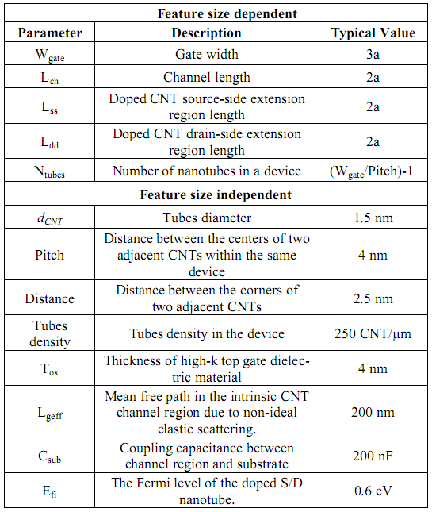
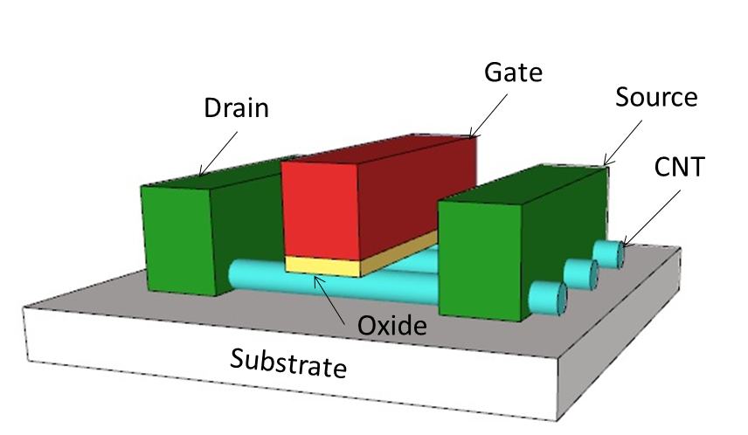
EXTRA CNFET

Slide 24
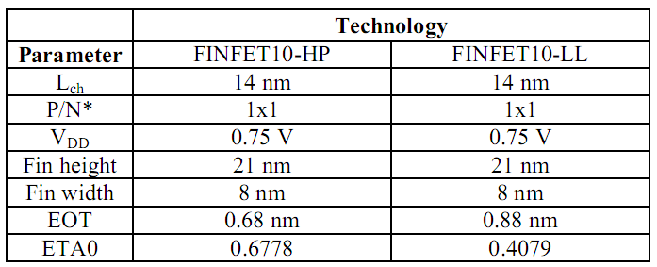
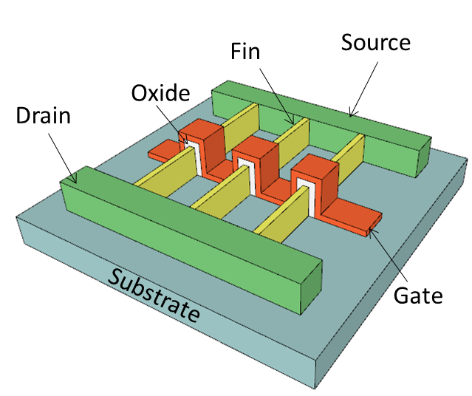
EXTRA FINFET

Slide 25
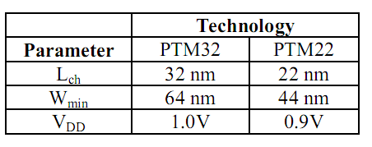
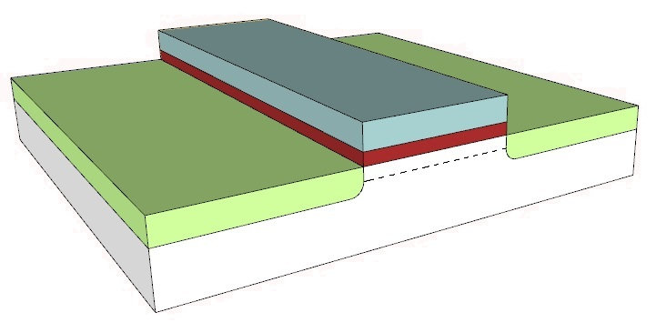
EXTRA BULK
Gate
Drain
Source
Substrate
Oxide

